Slide 1
RSM222
Management Accounting 1
Class 3: Student Handout
Elisa Zuliani

Slide 2
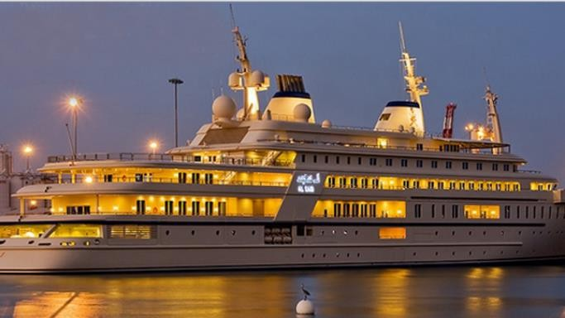
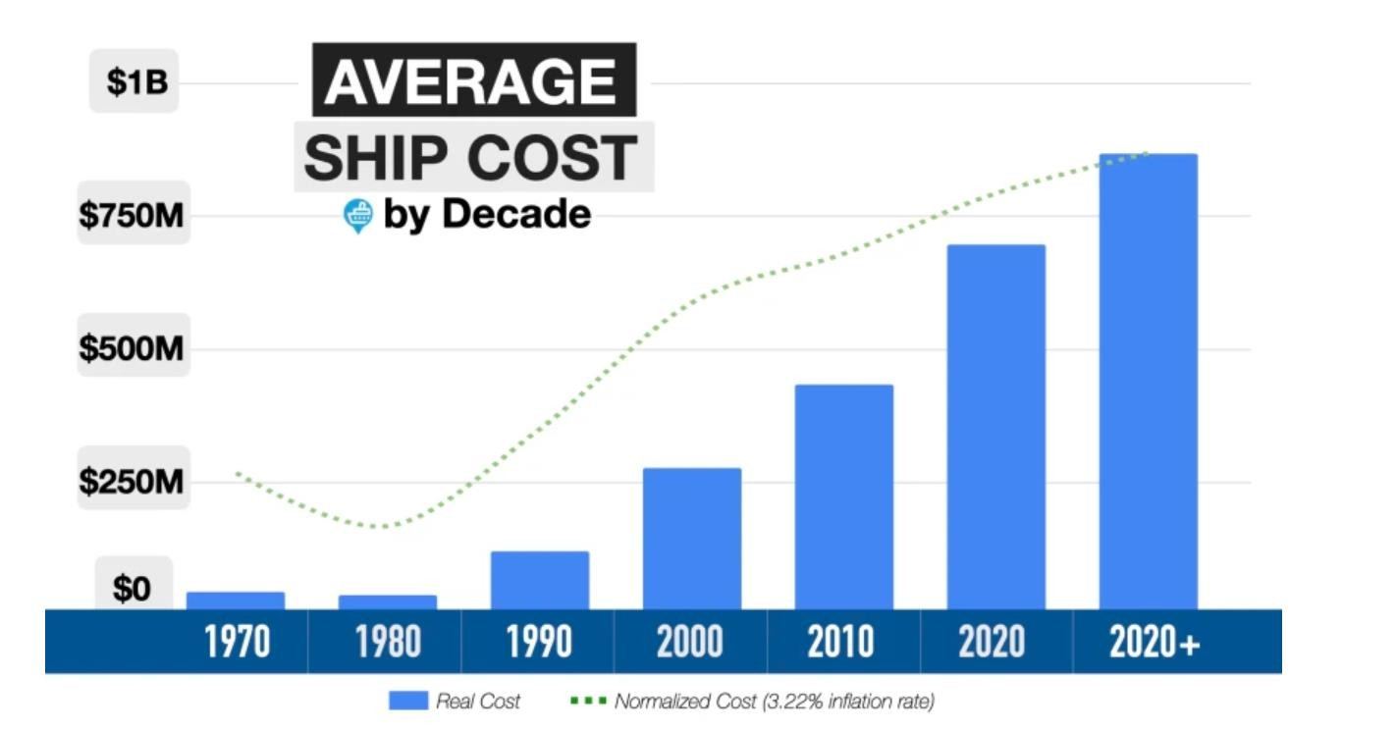
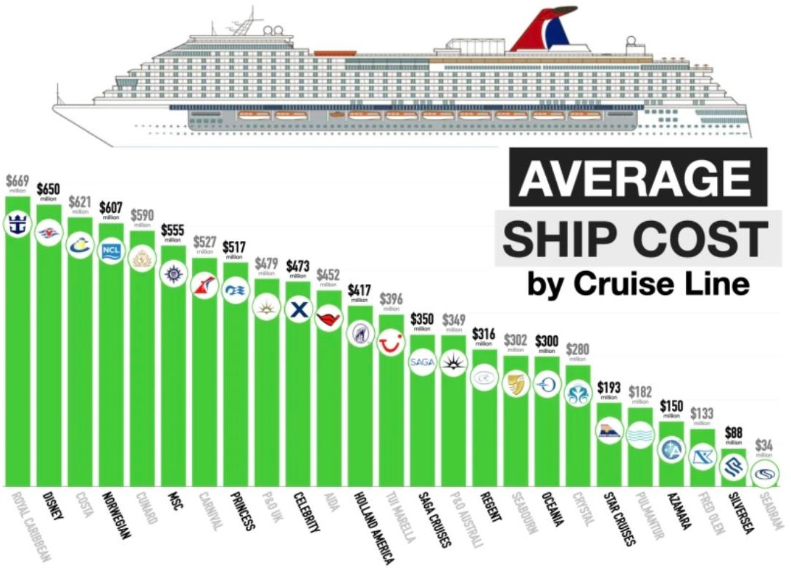
IN CLASS EXAMPLE
Yacht International Inc (YII)
Fun Fact of the Day:

Slide 3
Yacht International Inc. (YII) Part 1
Yacht international Inc (YII) is a private company that manufactures luxury yachts. As each yacht is highly customized and requires specific materials and labour expertise, YII tracks the costs of each unit individually. They recently completed the production of a customized yacht and they provided you with the following information.
The time sheets for all the employees that worked on the yacht indicated a total of 320 hours
and a total cost of $45,000.
The Job Cost sheet for the materials used on the yacht totalled $225,000.
The estimated indirect costs that relate to the production of yachts are:
  Management Salary: $1,500,000 per year
  Equipment Depreciation: $375,000 per year
  Plant Depreciation: $225,000 per year
  Utilities: $300,000 per year

Slide 4
Yacht International Inc. (YII) Part 1
Management normally allocates all overhead costs based on labour hours with the exception of the equipment depreciation which is allocated on a machine hour basis.
The estimated total labour hours were 25,000 while the estimated total
machine hours for 2017 were 50,000.
The number of machine hours used for this yacht was 500 hours.

Slide 5
Yacht International Inc. (YII) Part 1
Step | Description | How
1) | Identify cost object
2) | Identify and track direct costs
3) | Identify indirect costs
4) | Select cost allocation basis for indirect costs
5) | Compute rate of indirect cost allocation
6) | Allocate indirect costs to cost object
7) | Compute total costs for the cost object

Slide 6
Yacht International Inc. (YII) Part 1
Step | Description | How
1) | Identify cost object | The customized Yacht
2) | Identify and track direct costs | Direct Materials: $225,000 Direct Labour: $45,000 Total Direct costs = $270,000
3) | Identify indirect costs | Management Salary: $1,500,000 per year Equipment Depreciation: $375,000 per year Plant Depreciation: $225,000 per year Utilities: $300,000 per year

Slide 7
Yacht International Inc. (YII) Part 1
Step | Description | How
4) | Select cost allocation basis for indirect costs | Equipment Depreciation: Machine Hours Management Salary, Plant Depreciation: Utilities: Direct Labour Hours
5) | Compute rate of indirect cost allocation | Rate for DMH: $375,000 / 50,000 = $7.5 Rate for DLH: $1,500,000+225,000+300,000 =$2,025,000 / 25,000 = $81
6) | Allocate indirect costs to cost object | DMH: 500 * $7.50 = $3,750 DLH: 320 * $81 = $25,920 TOTAL INDIRECT = $ 29,670
7) | Compute total costs for the cost object | $270,000 + $29,670 = $299,670

Slide 8
Yacht International Inc. (YII) Part 2
It is now December 31st and YII’s controller provides you with the following information with regards to the production costs for the past year.
The actual costs incurred during the year with relation to the yacht production
Management Salary: $1,525,000 per year
Equipment Depreciation: $375,000 per year
Plant Depreciation: $225,000 per year
Utilities: $360,000 per year
In addition, the controller indicates that the production of yachts during the year required 27,200 labour hours and 47,000 machine hours. At the end of the period, the overhead costs applied between the various accounts are as follows:
Account | $ Overhead Allocated
WIP | $333,150
Finished Goods | $65,300
COGS | $2,157,250

Slide 9
Yacht International Inc. (YII) Part 2
Determine the amount of Over or Under Allocated Overhead Manufacturing overhead for the year.
Indicate what is the appropriate accounting treatment for over and under allocated overhead and prepare the journal entry to adjust the over or under allocated manufacturing overhead costs for YII.

Slide 10
Yacht International Inc (YII) Part 2
1. Determine the amount of Over or Under Allocated Overhead Manufacturing overhead for the year.
MOH (T-Account)
Actual OH | Applied OH
MOH (T-Account)
MS: $1,525,000 | DLH:
Eq: $375,000 | $81 * 27,200 =
Plant: $225,000 | 2,203,200
Util.: $360,000 | DMH:
 | $7.5 * 47,000 =
 | $352,500
$2,485,000 | $2,555,700
Actual OH costs ≤ OH Costs applied to WIP. Difference: $70,700

Slide 11
Yacht International Inc. (YII) Part 2
2. Indicate what is the appropriate accounting treatment for over and under allocated overhead and prepare the journal entry to adjust the over or under allocated manufacturing overhead costs for YII.
UNDER APPLIED OVERHEAD COSTS | Close the difference to COGS COGS……………………….XXX Manufacturing OH…………..XXX
OVER APPLIED OVERHEAD COSTS | Allocate difference between WIP, Finished Goods and COGS in proportion to the OH applied during the period.

Slide 12
Yacht International Inc. (YII) Part 2
2. Indicate what is the appropriate accounting treatment for over and under allocated overhead and prepare the journal entry to adjust the over or under allocated manufacturing overhead costs for YII.
Account | $ OH Allocated | % | % * Overapplied OH
WIP | $333,150 | 13.03% (333,150/2,555,700) | $9,211 (13%*70,700)
Finished Goods | $65,300 | 2.56% (65,300/2,555,700) | $1,810
COGS | $2,157,250 | 84,41% (2,157,205/2,555,700) | $59,679
 | $2,555,700 | 100% | $70,700
DR MOH $70,700
CR WIP $9,211
CR Finished Goods $1,810 CR COGS $59,679
What if you don’t have $OH allocated?

Slide 13
Any Questions?

